Slide 1

Photon and Neutron facilities in EOSC: Overview, Challenges, Opportunities
Proposal submitted to the INFRAEOSC-4-2018 call.
Partners: ESRF (coordinator), ILL, XFEL.EU, ESS, CERIC-ERIC, ELI, EGI
Collaborations: GÉANT, EUDAT, national RIs

Slide 2
PaNOSC Proposal
Partners : 5 ESFRIs + 1 ERIC + 3 e-Infras
Submitted : 22 March 2018
Budget : 12 million euros
Start Date : 1/1/2019
Length : 4 years
Proposals submitted : 5
Decision : 22 August

Slide 3
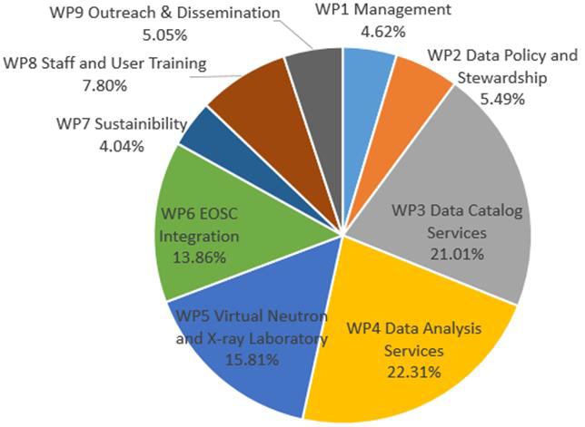
PaNOSC Work packages effort
WP1 – Management (64)
WP2 – Data policy and stewardship (76)
WP3 – Data catalogue services (291)
WP4 – Data analysis services (309)
WP5 – Virtual Neutron and X-ray lab (219)
WP6 – EOSC integration (192)
WP7 – Sustainability (56)
WP8 – User training (108)
WP9 – Outreach (70)

Slide 4
The community
50,000 users – Biology, Medicine, Materials, Chemistry, Nuclear Physics, Particle Physics, Cultural heritage, Geology … and industrial applications.
State of the art Large Scale Facilities – 5 ESFRI + 25 national RIs (PaNs)
Data policies implementing FAIR principles – PaNdata data policy
10s of Petabytes of scientific data, curated and archived for 5-10+ years
PaNs manage and provide access to data from experiments across Europe
Working together in past and ongoing projects – PaNData, SINE2020, CALIPSOPlus, EUCALL, LEAPS, …

Slide 5
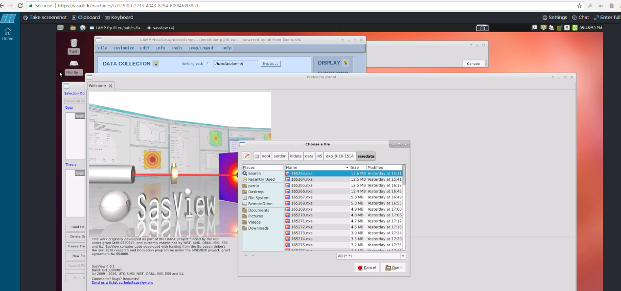
What we want to provide
Curated Open Data and metadata of the highest quality
Reliable services dedicated to understanding and to further exploiting these data
Technical and scientific support on these data and data services
Our experience on FAIR data policies and FAIR implementation guidelines for Photon and Neutron science
Our knowledge and understanding of our scientific community
Our ability to promote FAIR culture amongst our community
Objective: Create a new class of virtual users of Open Data from PaN RIs

Slide 6
Data Policies
2008 – PaNData policy framework
Adoption by several facilities (ILL, ESRF, PSI, ELETTRA, HZB, …)
Align user experience about policy
PaNOSC: updated Data Policy framework:
Lessons learned from the community
Better understanding of FAIR
Align with other EOSC projects/clusters work on DP.
Common guidelines
Minting DOIs, long term archiving, downloading and citing data, ….
Implementing DMP template

Slide 7
Data + Metadata
2015 – Nexus data format https://doi.org/10.1107/S1600576714027575
Nexus is the de facto standard (What else ?)
Adopted by most synchrotrons
Not perfect but continuously improving
PaNOSC: adopted Nexus as standard:
Lessons learned from the community
Work closely with Nexus Committee (NIAC)
Collect rich metadata on all experiments
FAIR principles require rich metadata
Common guidelines
Define new metadata standards where missing, share metadata catalogues or definitions based on Nexus, ….
Store data in HDF5 with Nexus conventions

Slide 8
Data Catalogues
https://icat.esrf.fr
https://data.ill.eu …
Standard metadata available via OAI-PMH (service provided by DataCite) indexed by OpenAIRE
Development of an API to allow federation of metadata catalogues and exposure of metadata relevant for the area.
Provisioning Federated Search
Linked with EOSC-Hub data catalogue(s)
Searching all PaNOSC partner sites for available datasets

Slide 9
Data Analysis Services
Enabling transition from measurements to insight and new science
Providing raw data is not enough … we also need to provide specific services for extracting scientific knowledge.
Web remote desktop based analysis services
Provide generic solution for analysis software
Web notebook based analysis services
Focus on reproducible and publishable data analysis
Integration into EOSC service portfolio
Moving from single facility to EOSC scope

Slide 10
Simulation Services
Simulations of the various parts and processes involved in complex experiments play an increasingly important role in the entire lifecycle of scientific data generated at RIs.
Expose source, beamlines optics and scattering simulations as cloud services
Expose simulation data services in data analysis frameworks accessed via Jupyter notebooks or remote desktop solutions.
Integration into EOSC service portfolio

Slide 11
Support & Training
Expanding from facilities’ users specific support and training to PaN cluster and EOSC users.
Integrated technical and scientific Helpdesk that will give support to data scientists
E-learning platform (à la e-neutrons)
Staff training in data stewardship
Participate in scientific schools (Hercules) to promote FAIR principles and introduce the use of EOSC services

Slide 12

Working with
Active participation in governance.
Active Participation in open policies activities.
Integration of our data catalogues into the EOSC data catalogue.
Use of E-Infra IT services to deploy more specific services targeted at Photon and Neutron data type and users.
Provisioning of models and solutions to bring small datasets to the compute resources and vice versa for very large datasets.
Commonly defined service quality levels (Service Level Agreements) and if necessary upgrade the services to reach and maintain reliably this level of quality.
Commonly defined usage metrics and the adoption of the necessary tools to collect and publish them.
Harmonization of solutions for federated identity provisioning, authentication and authorization.
Set up a technical and scientific support structure for handling data scientist (not necessarily facility users) requests
Promoting FAIR data culture.

Slide 13
Key challenges with e-infrastructures
Integrating our services into EOSC Hub Service Catalogue
SLA Standards
Metrics and monitoring
Providing compute capacity for DAAS services
Data availability for the services
Moving data to the services (FTS3)
Moving the computing capacity to the data
Integrate PaN Software catalogue into EOSC marketplace
Models for AAI integration (GEANT)
Data archiving pilot (EUDAT)

Slide 14
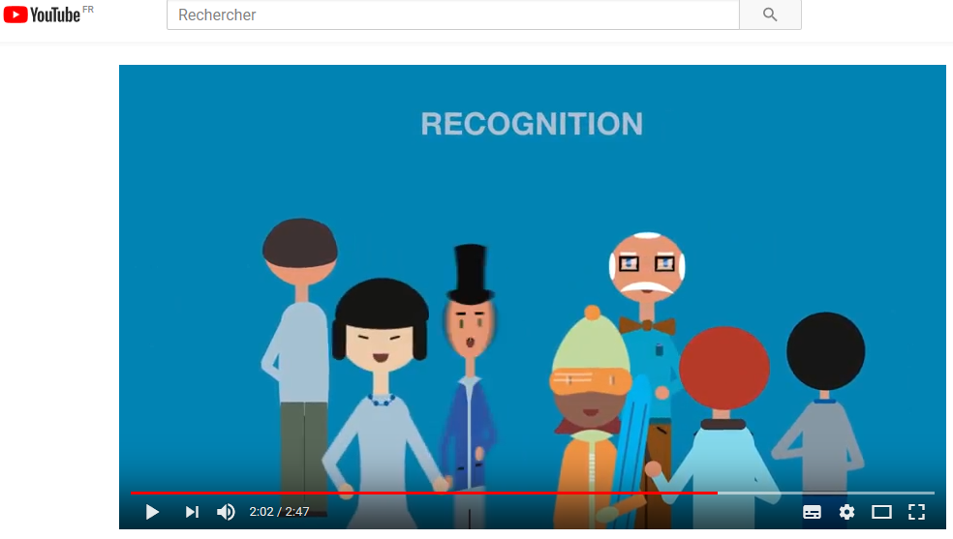
Stewardship of Open Data following FAIR principles … all together
https://www.ill.eu/DOIs
https://youtu.be/40B28q8EUyI

Slide 15
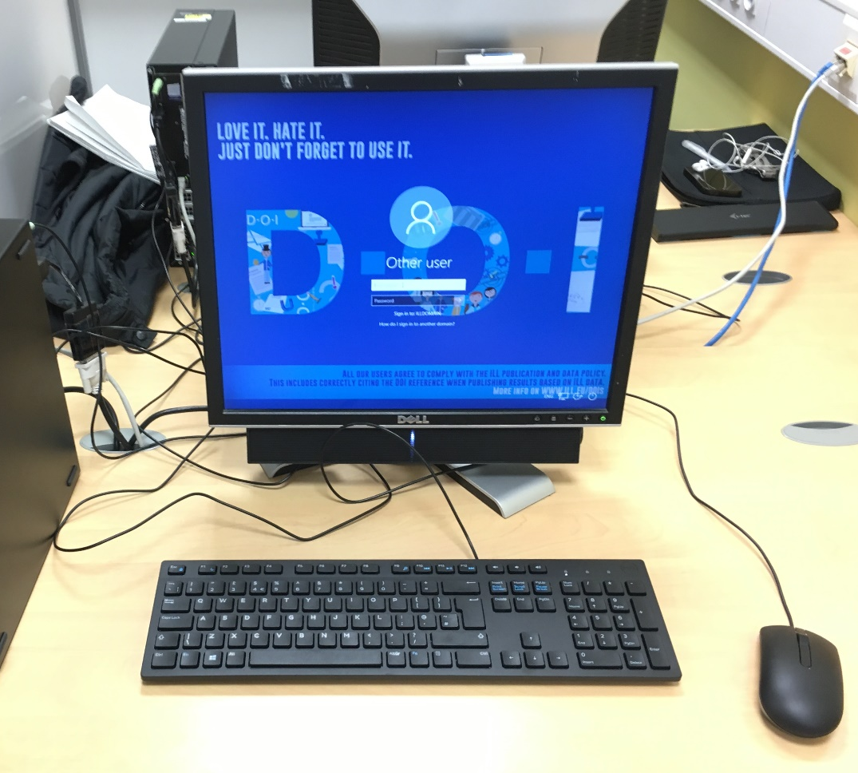
Digital Object Identifiers (DOIs)
https://www.ill.eu/DOIs

Slide 16
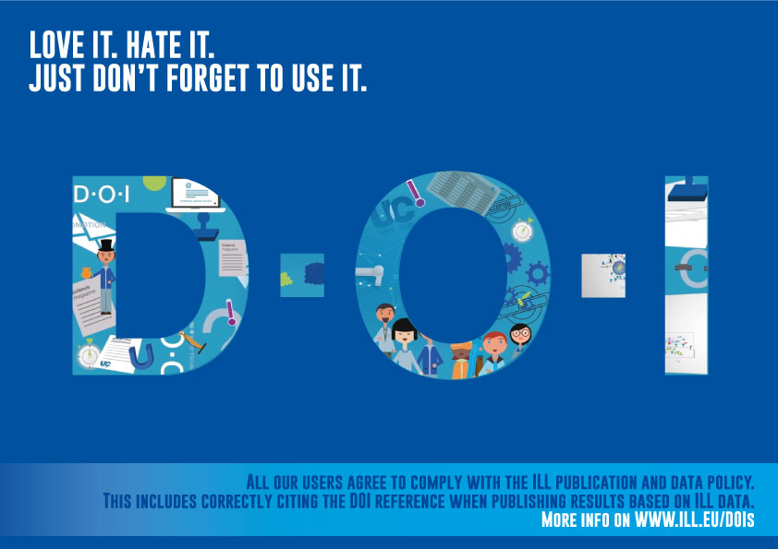
https://www.ill.eu/DOIs

Slide 17
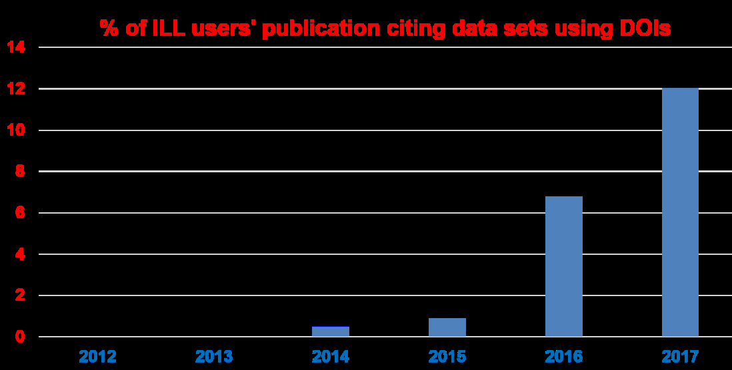
We cannot do it alone …
We need complete and focused participation from all parties: Universities, Publishers, RIs, e-Infra, EC, …

Slide 18
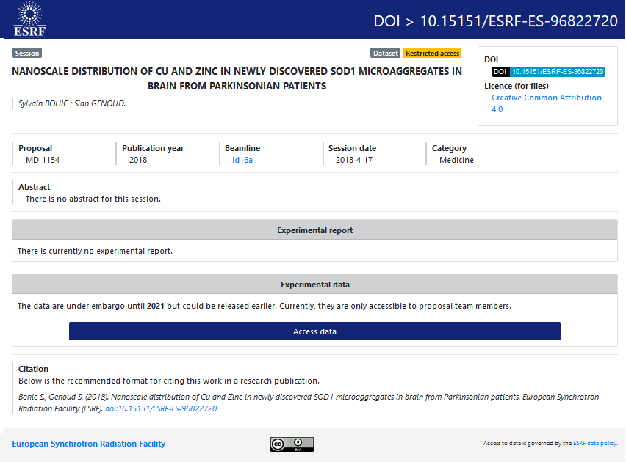
ESRF DOIs
New service
implemented as
part of data policy
and long term
data archiving
https://doi.esrf.fr/
An essential step
for Open Data

Slide 19
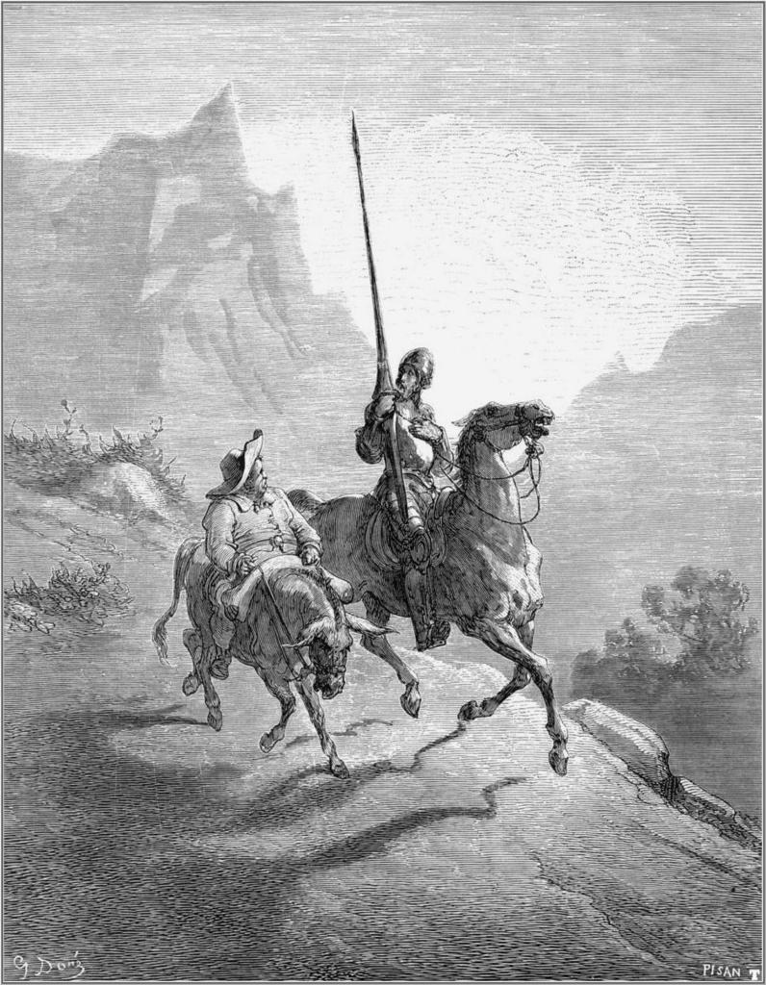
We seek Collaboration with experts
in data management
and scientists
We need to work
together with
National RIs on
Open Data and
Data Analysis as a
Service !
andy.gotz@esrf.fr, perrin@ill.eu
Don Quichotte and Sancho Panza, drawn by Honoré Daumier

